Slide 1


Introduction to statistics using R
Seminar series - session 2

Slide 2
Session 2 – Learning objectives
Understand the concept of probability distribution
A very short intro to R and Rstudio

Slide 3

But first,

Slide 4
Distribution
The concept of distribution is the soul of data analysis
If you understand distribution, then you’ll understand stats
Statistical tests assume data follow specific distributions

Slide 5
What is distribution?
Probability distribution
Mathematical function defining all the possible values of a random variable, and how often they occur
Within a given range
Describes the long-run behavior of random variables
How the possible values are plotted depends on:
Central tendency
Spread
Skewness
Curtosis (among others)

Slide 6

Do not confuse
Frequency vs probability
distribution

Slide 7
Frequency and probability distribution
Frequency:
Empirical
Summarizes observed data
Probability:
Theoretical
Calculates the observation probabilities

Slide 8

An example
We captured 5 sandgrouses, 7 ravens, and 3 falcons
Frequency distribution of species is 5, 7 and 3
Probability distribution of species is 5/15, 7/15 and 3/15

Slide 9
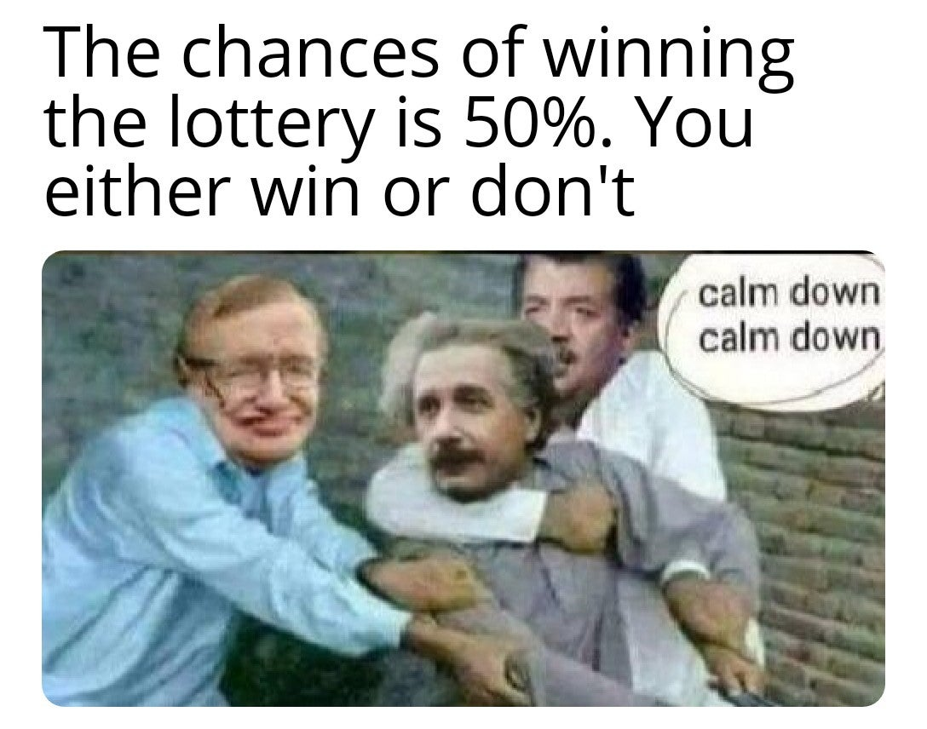
Why use probability?
Data come from experiment or complex systems
Variability and randomness
Measure uncertainty in the data
Probability measures uncertainty

Slide 10

Some definitions
random variable: variable which outcome varies from measurement to measurement
Probability distribution: possible values a random variable can take, and how likely they are
Behavior of random variables must be defined using probability.

Slide 11

Do not confuse random variable and variable
A random variable is always numerical and depends on the outcome of a chance experiment.
A variable is any property that you can measure or control

Slide 12

Unfortunate choice of words
Random variables: not random & not variables. They are functions mapping from possible outcomes of sample space to measurable space
Categorical variables can also describe random outcomes

Slide 13

Some more definitions
Chance experiment
Uncertain situation with 2 or more possible outcomes

Slide 14

Chance experiment
Uncertain situation with 2 or more possible outcomes
Your dragonborn barbarian wants to open a closed door in the dungeon using her Sword of Vengeance.
When you roll your d20 to perform the deed, you’ll have 20 possible outcomes from nat 1 to nat 20.

Slide 15


Some more definitions
Outcome
Result of a single trial
You rolled your d20 and got a nat 1.

Slide 16

Some more definitions
Sample space
Collection of all possible outcomes from a chance experiment
The sample space when rolling your d20 is all integers from 1 to 20.

Slide 17

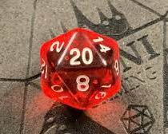
Some more definitions
OR
Event
Set of outcomes from a chance experiment
Event “nat. 20 or 1”: all dice rolls that are either 20 or 1.

Slide 18

Some more definitions
Probability
Mesure of likelihood of an event occurence
The Barbarian dragonborn rolls nat 1 three times in a row, almost killing off the party.
What was the probability?
1/20*1/20*1/20 = 1/8000 = 0.000125

Slide 19
Probability Distribution
Continuous
Discrete

Slide 20
Probability Distribution
Continuous
Discrete
Continuous variables

Slide 21
Probability Distribution
Continuous
Discrete
Continuous variables
Continuum of value within range

Slide 22
Probability Distribution
Continuous
Discrete
Continuous variables
Discrete variables
Continuum of value within range

Slide 23
Probability Distribution
Continuous
Discrete
Continuous variables
Discrete variables
Continuum of value within range
Only takes distinct values

Slide 24
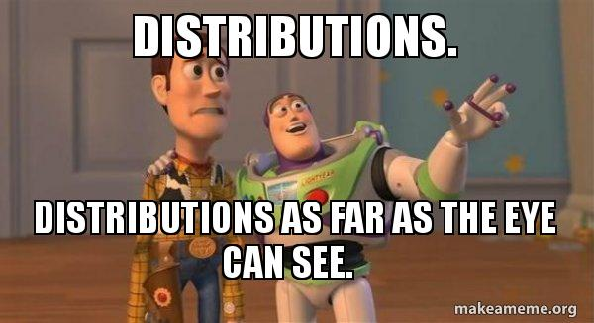
Most common distributions
Continuous variable:
Normal (a.k.a. Gaussian)
Uniform (a.k.a. rectangular)
Beta
gamma

Slide 25
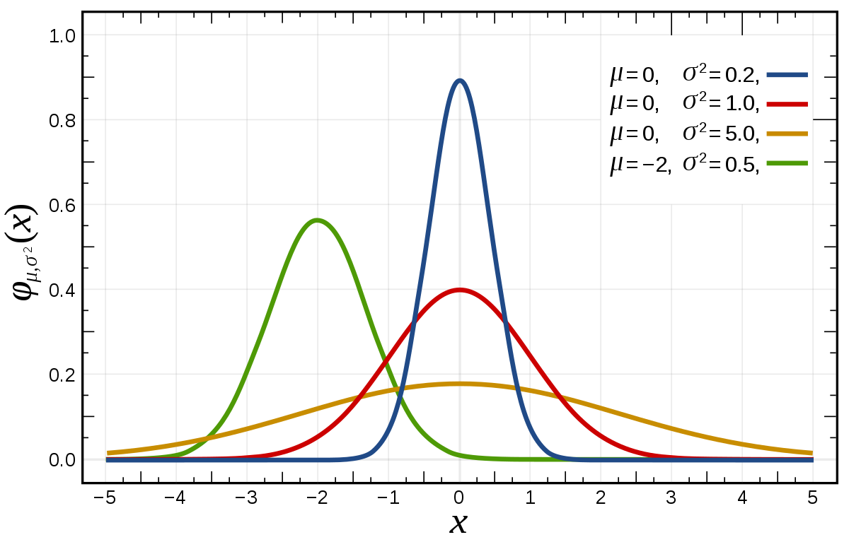
Gaussian or Normal distribution
Symmetrical
Defined by μ and σ

Slide 26
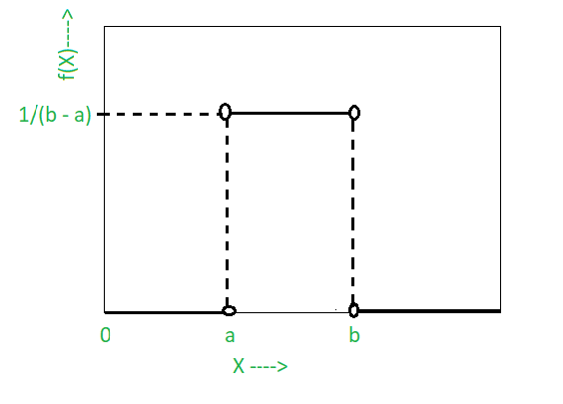
Uniform or rectangular distribution
Defined by a (minimum value) and b (maximum value)
Constant probability over interval [a-b]

Slide 27
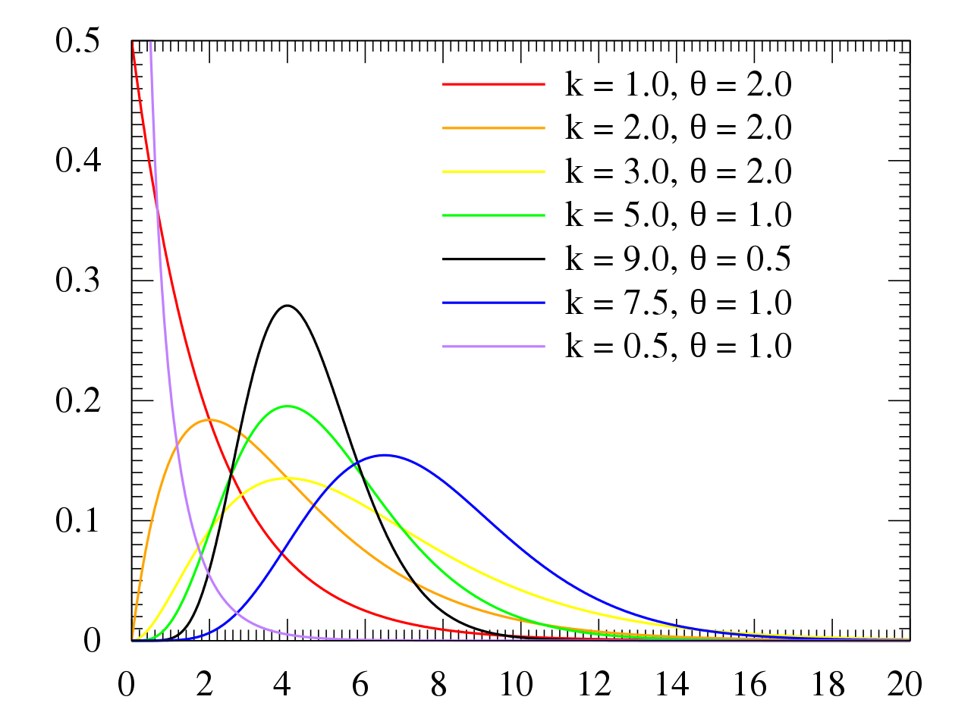
Gamma distribution
Positive and right-skewed
Defined by parameters k (shape) and θ (scale)
Continuous, positive, right-skewed data with constant variance on the log-scale
Survival data, rainfall,…
χ² distribution: special case of gamma
Used in χ² goodness-of-fit tests

Slide 28
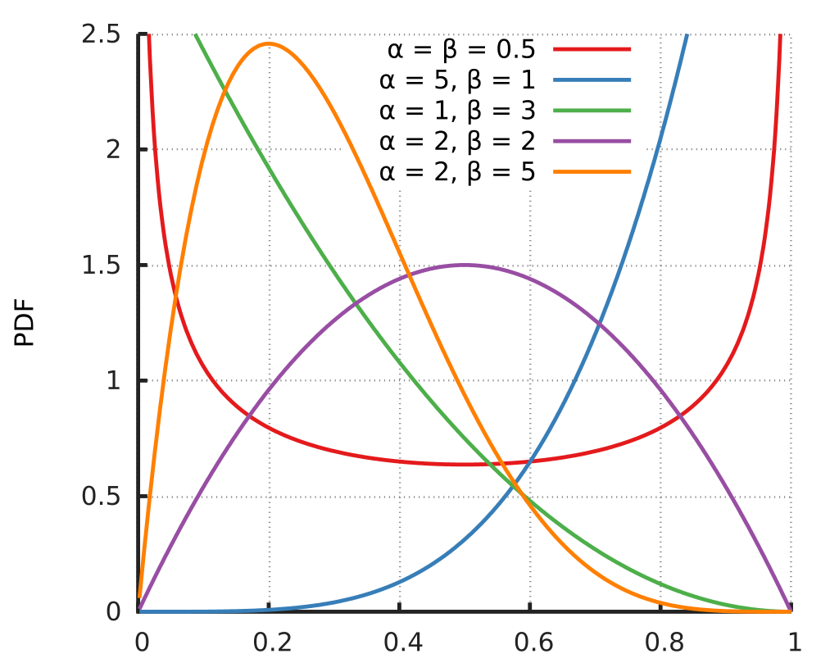
Beta distribution
Defined on [0,1]
Defined by shape parameters α and β, both >0

Slide 29
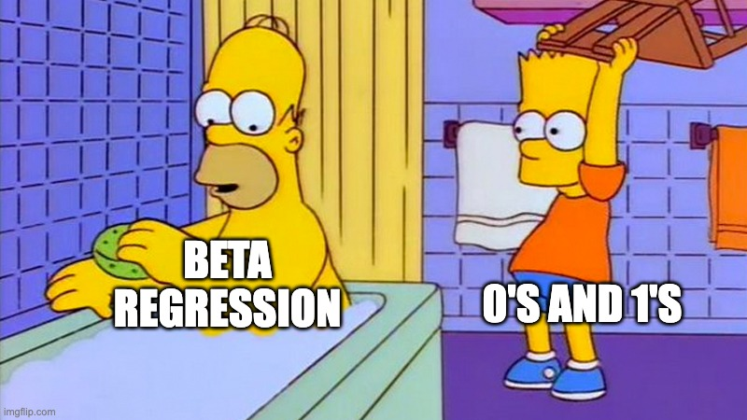
Beta distribution
Derived variables, notably proportions
Doesn’t deal with exact 0s and 1s (loglikelihood function contains ln(x) and ln(1-x), and thus unbounded since ln(1) = 0 and ln(0) = -∞ )
When 0 and 1 occur:
Possible transformation: (y * (n−1) + 0.5) / n, n = sample size
Zero-one inflated beta models

Slide 30
Most common distributions
Discrete variables:
Uniform (Yes, again!)
Poisson
Negative Binomial
Binomial

Slide 31
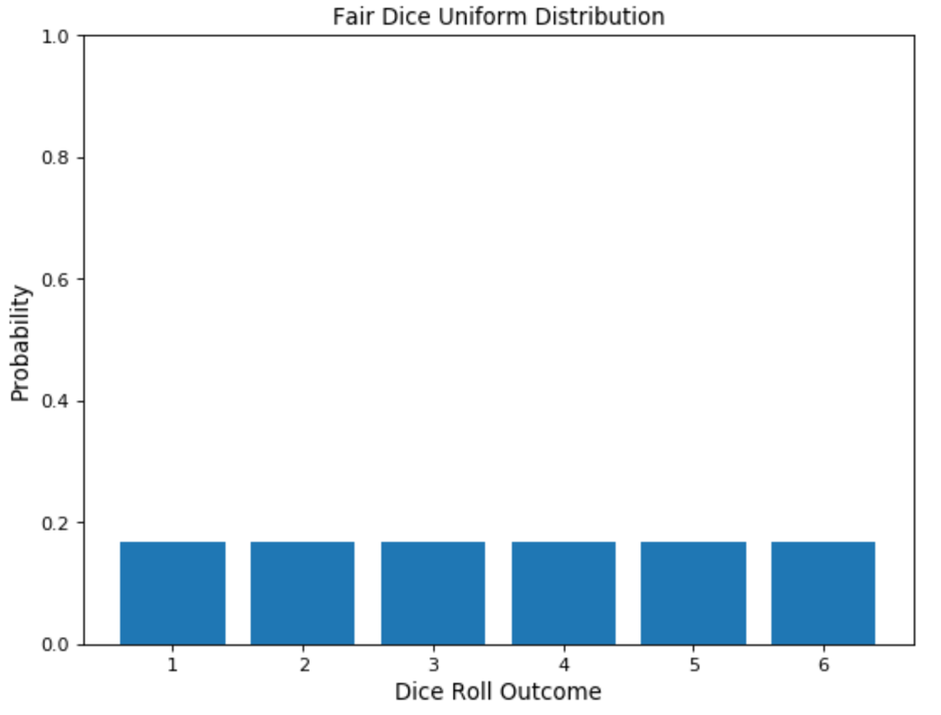
Discrete uniform distribution
All outcome equally likely
Defined by a (min) and b (max) like the continuous
1n

Slide 32
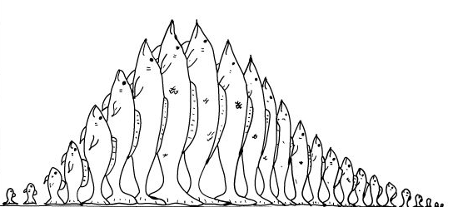
The Poisson distribution
Count distribution
Defined by 1 parameter λ mean number of events
λ = μ = σ² (lambda = mean = var)

Slide 33
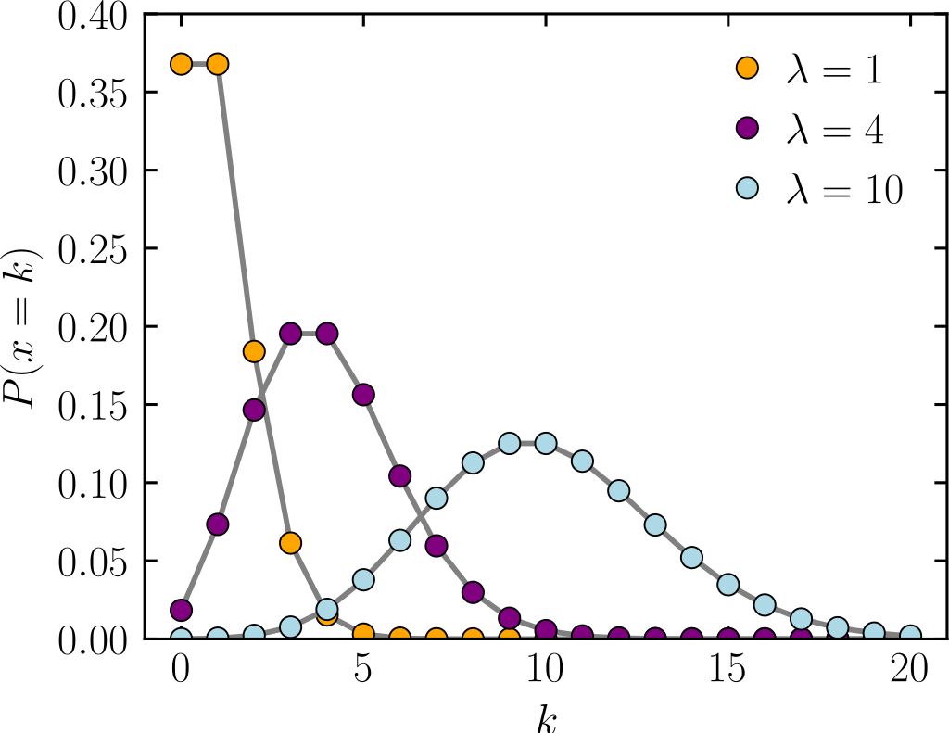
The Poisson distribution
As mean increases, Poisson distributions approximate normal distribution
Count data with large mean can often be modelled as continuous
Expected relative frequency
K (# times event occurs)

Slide 34
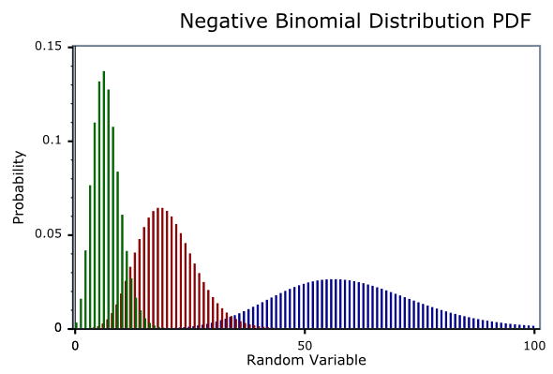
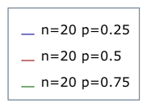
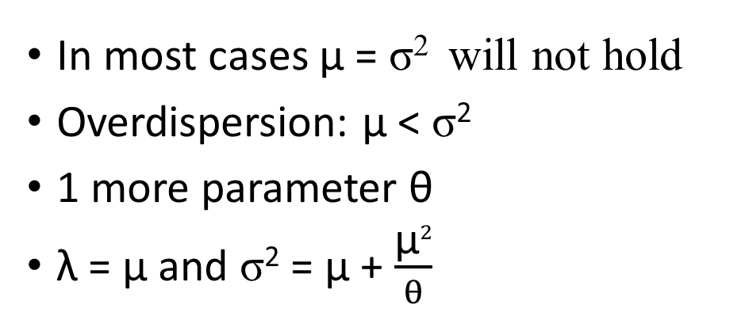
Negative binomial distribution
In most cases μ = σ² will not hold
Overdispersion: μ < σ²
1 more parameter θ
λ = μ and σ² = μ + $\frac{\text{μ}2}{θ}$

Slide 35
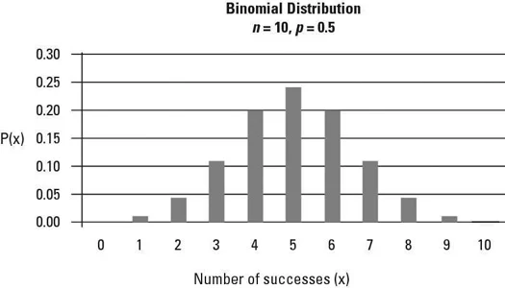
Binomial distribution
Series of Bernoulli trials
Bernouilli trials: only 2 outcomes
Binary variable: 1/0
# of 1 in n independent Bernoulli trials
Defined by n (# trials) and p (probability of success in 1 trial)

Slide 36
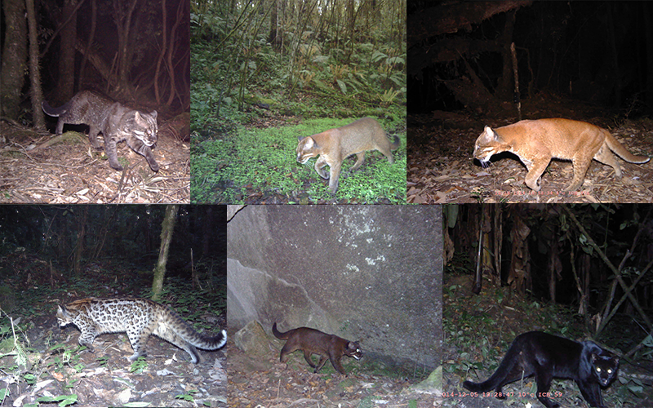
Categorical distributions

Slide 37
Which morphs are associated with which habitat?
Coat color: response variable with k categories
Multinomial distribution: possible results of a random variable that can take on one of K categories, given the specified probability of each category
Generalizes the binomial distribution

Slide 38
Intro to R and RStudio

Slide 39

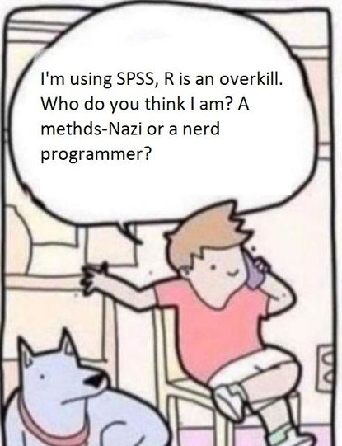

What is R?
A programming language
A calculator
An environment: integrated suite of software
Open source
Get under the hood, unlike most software: you know what you’re doing and what’s going on

Slide 40

Why is R?
Data handling
Computation
Graphics
Wide variety of:
Statistical techniques
Graphical techniques
Data-type it can handle

Slide 41


What is RStudio?
integrated development environment for R
A tool to make your life easier with R

Slide 42
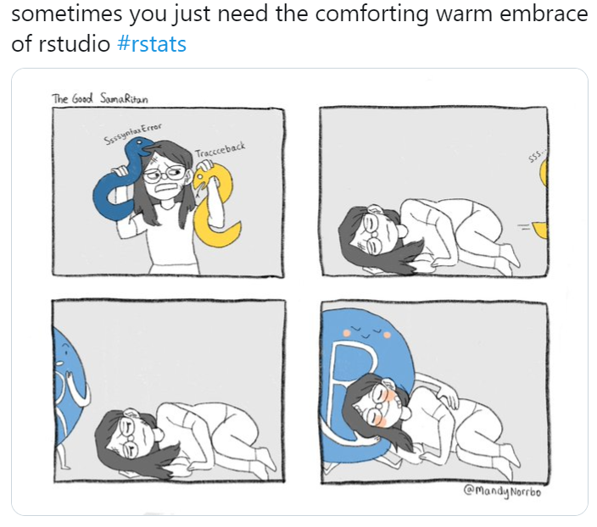
Why is RStudio?
tools for:
plotting
history
debugging
workspace management

Slide 43




R resources
https://r4ds.had.co.nz/ for data wrangling and graphs
List of sites I provided during the last seminar
I’m happy to help you trouble shoot your code, but from now on, I’m expecting you to first try these resources
Copy and paste errors in

Slide 44
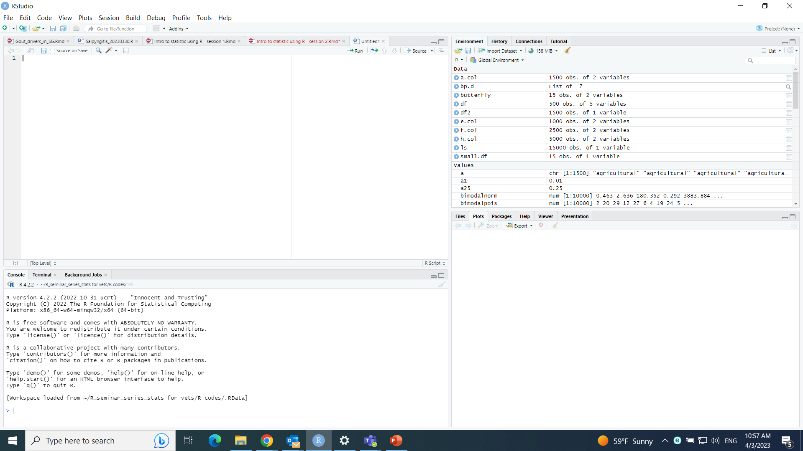
Panes in RStudio
3
1
4
2

Slide 45
Source editor
1
This is where you type your code
# will prevent whatever comments you add to be read as code
# you need to add the # symbol at the beginning of each line, which # you don’t want to run
You can also add # at the end of a code bit
The first part of the line will be seen as code # the second will not

Slide 46
Source editor
1
Source editor color convention: default theme
Black
Objects and anything you define or call
Blue
commands
Green
“characters”
# will not be considered as code, thus won’t run

Slide 47
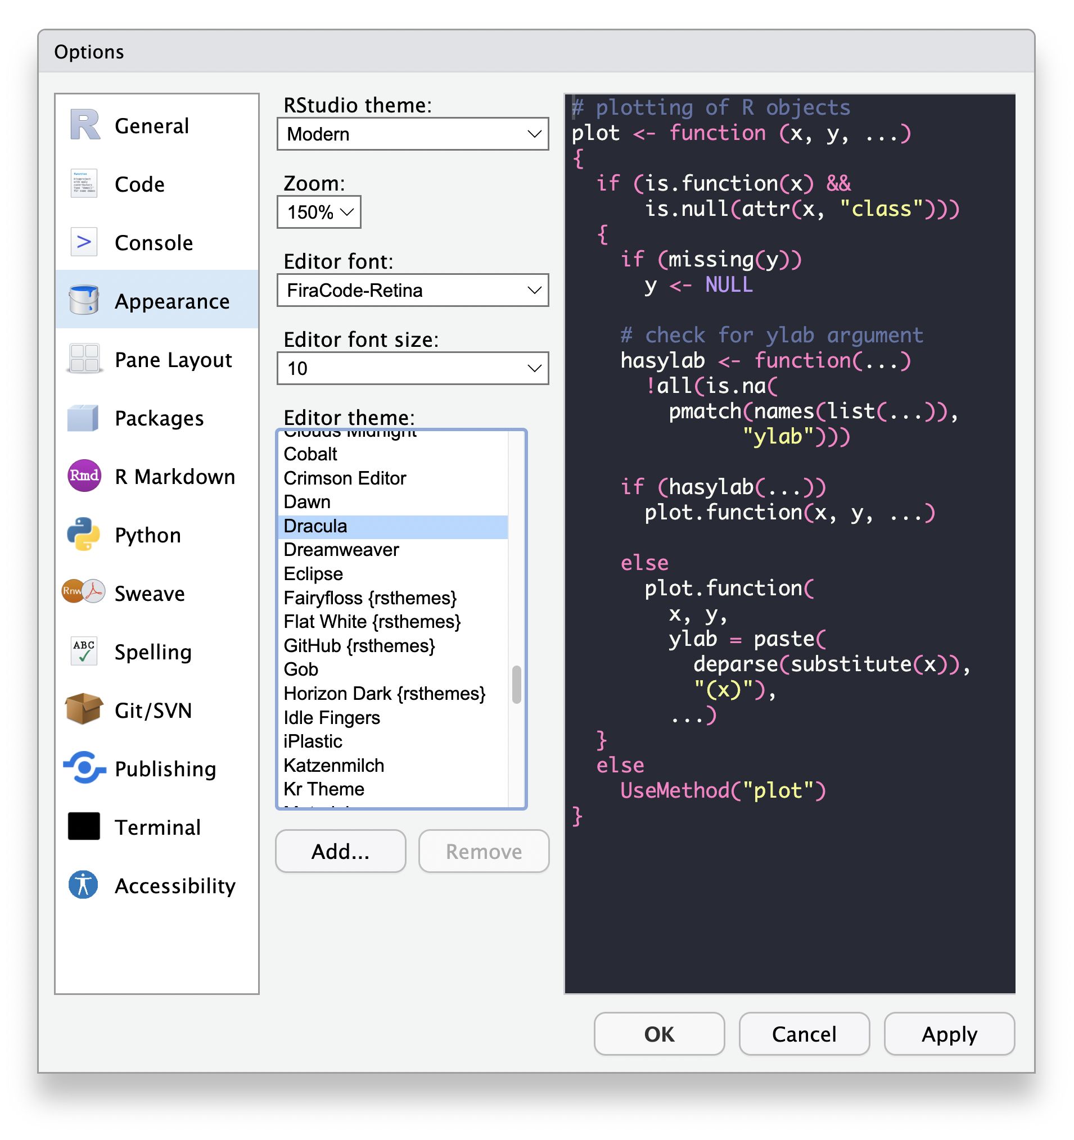
Source editor
1
But you can change the theme!

Slide 48
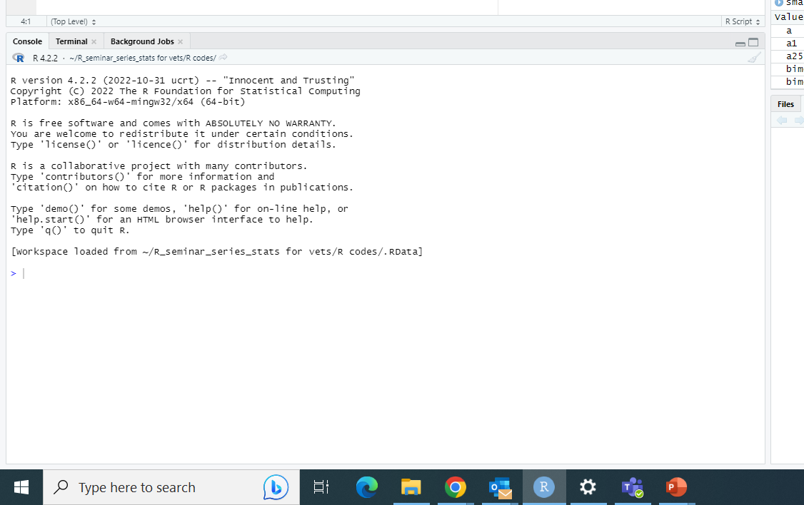
R Console
2
> This is actual R
> Your code runs here
> All commands are blue preceded by >
Output is black
Warnings and errors are red

Slide 49
R Console
2
> If you type code in the console
> It will be executed directly. Ex.:
> 3 + 2
[1] 5

Slide 50
Environment pane
3
Very useful
Shows all your objects

Slide 51
Environment pane
3
Dataframes, matrices, arrays and lists are under “Data”

Slide 52
Environment pane
3
Vectors or functions are under “values”

Slide 53
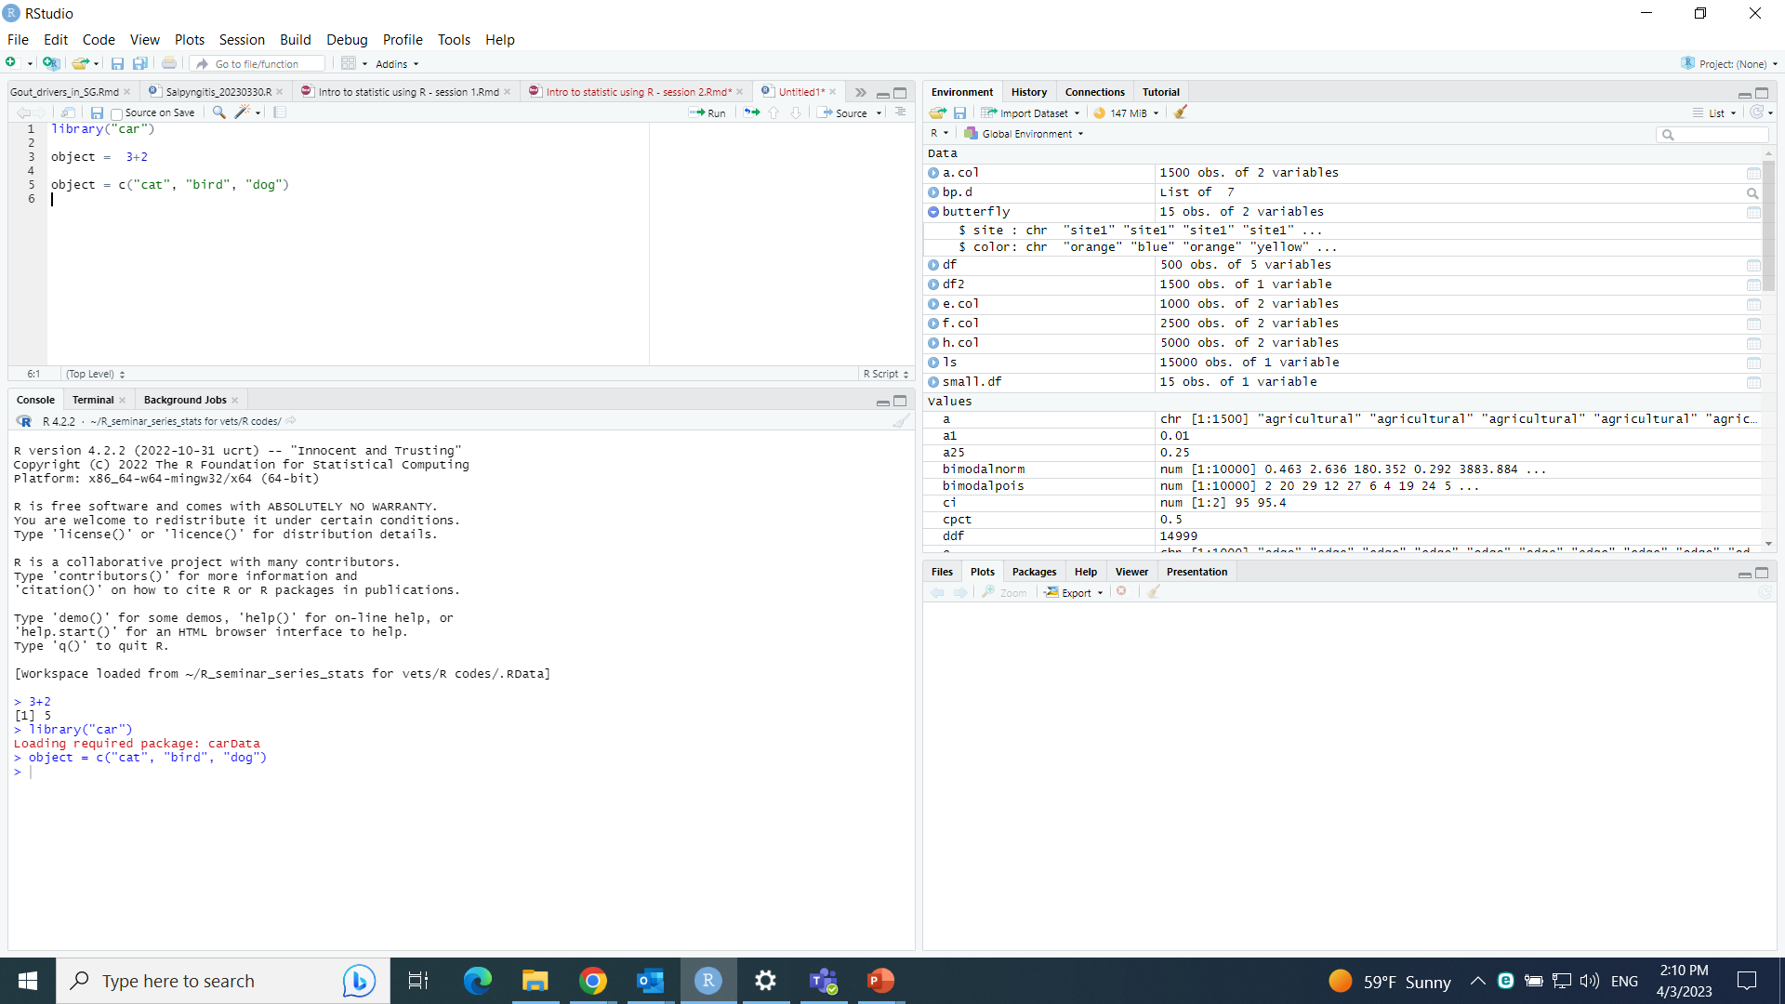
Environment pane
3
The pane indicates how many columns you have in you data frame, or the number of elements in a list

Slide 54
Environment pane
3
You can also see how many observations you have in your columns

Slide 55
Environment pane
3
When you click on the arrow

Slide 56
Environment pane
3
When you click on the arrow, you can see:
Columns of data frames
Elements of a list

Slide 57
Environment pane
3
R also indicates what operator you must use to call a particular element. For ex., butterfly$site calls the column “site” of data frame “butterfly”

Slide 58
Environment pane
3
You can also check the type of data (character, numeric…) stored in the column or list

Slide 59
Environment pane
3
Same for vectors, you can check the type of data

Slide 60
Environment pane
3
Same for vectors, you can check the type of data, and how many observations you have

Slide 61
Output pane
4
4 tabs of interest

Slide 62
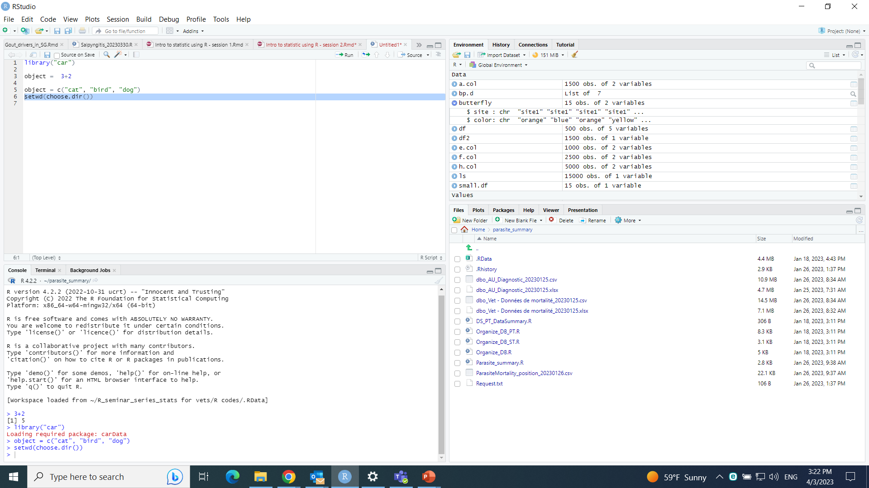
Output pane
4
The file tab is a navigation pane where you can manage files like in you operating system

Slide 63
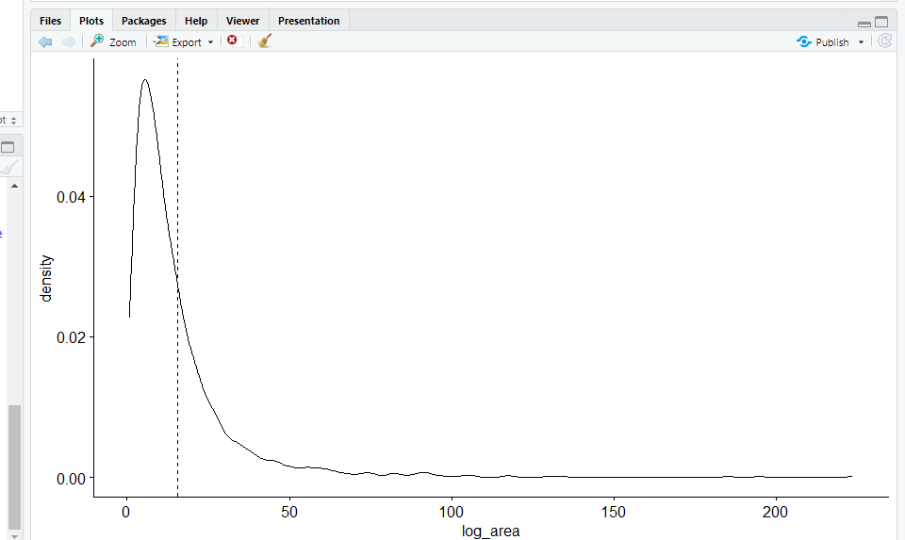
Output pane
4
The plot tab is where you can see you plots

Slide 64
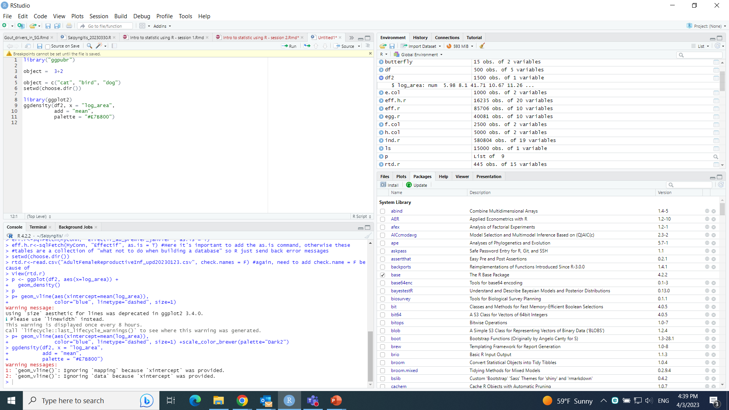
Output pane
4
The package tab shows the packages stored in your computer

Slide 65
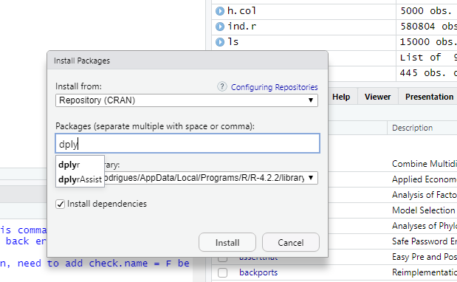
Output pane
4
The package tab also has the install button from which you can directly install packages

Slide 66
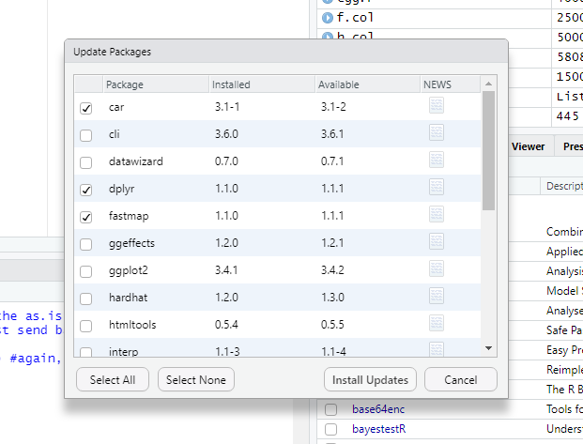
Output pane
4
Same to update already installed packages

Slide 67
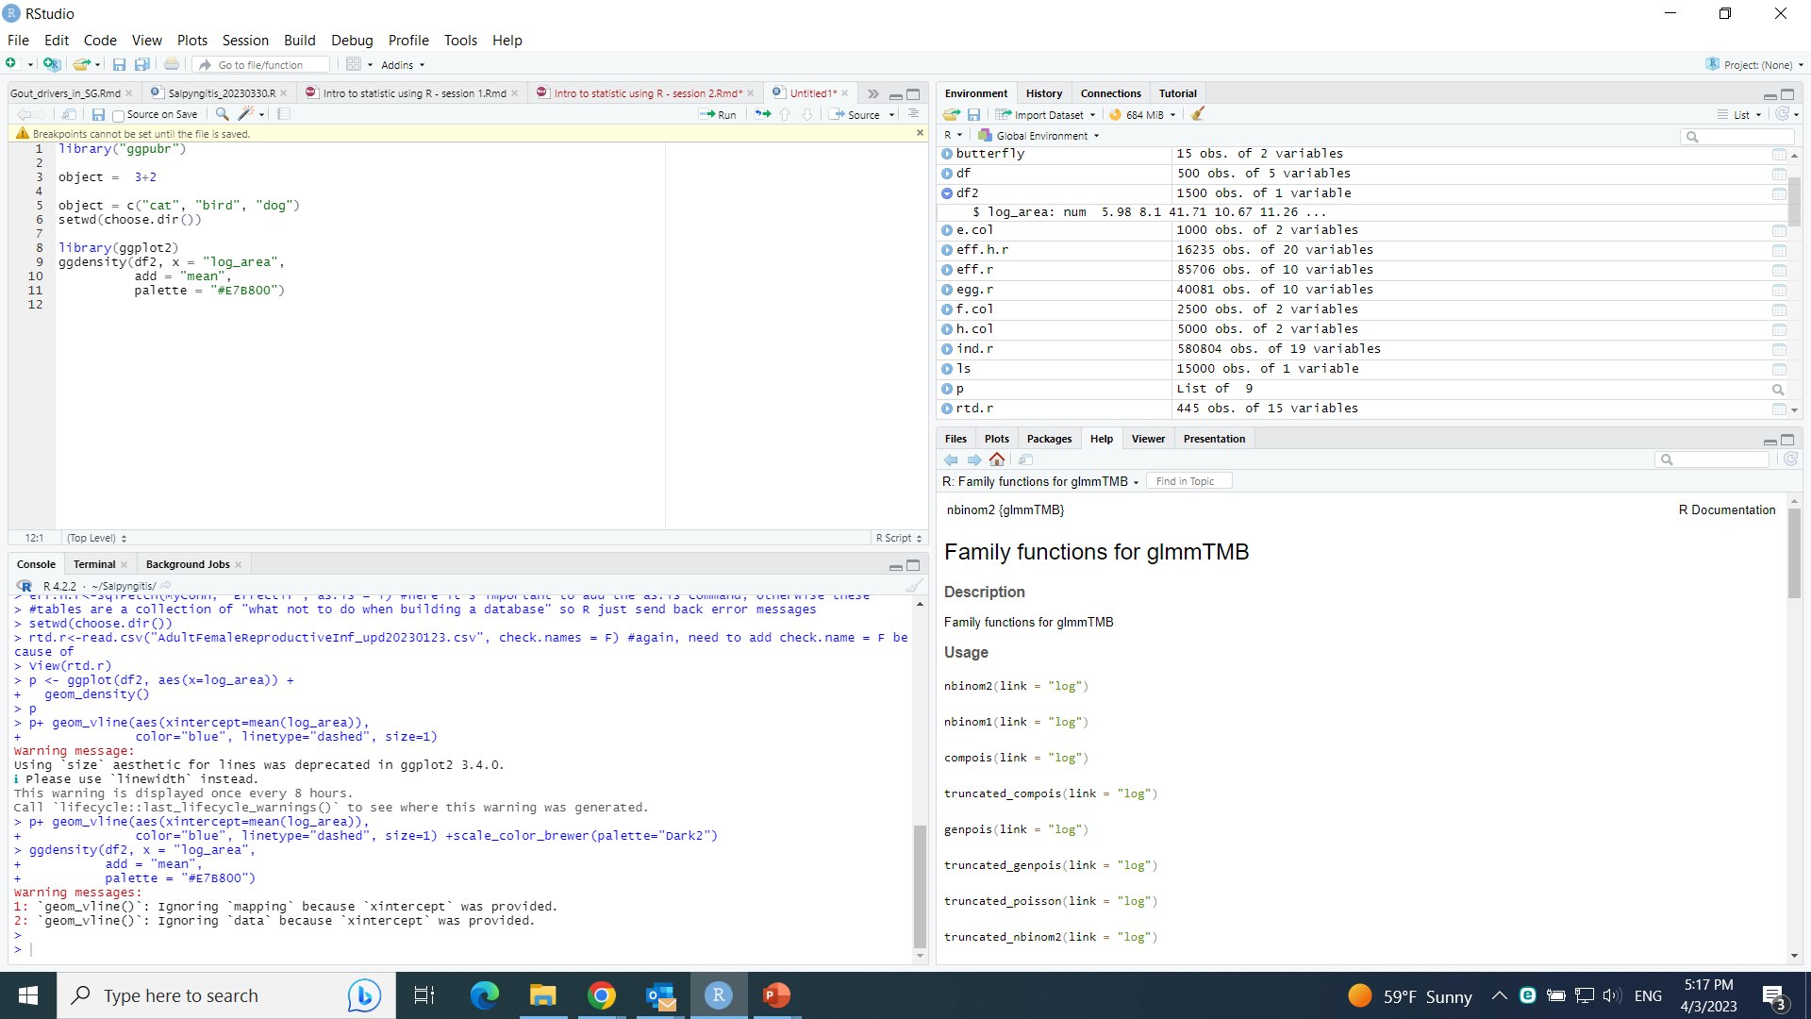
Output pane
4
The Help tab provides access to R documentation for all functions

Slide 68




